Slide 1

Crime Prediction
Kevin Ward(A20416479)
Harshitha Rangaswamy(A20400223)
Prerna Kumari (A20428292)
Kavyashree Shankar(A20381191)

Slide 2

Introduction
Crime prediction is potentially a powerful tool to be utilized by law enforcement.
Main obvious factors for increase in crime are unemployment and under poverty.
Aim of our project is to determine all other factors which affect the crime rate of a country
On considering these factors, there is possibility that the crime can be reduced.
For this reason we set out to teach algorithms to predict violent crime rates.

Slide 3
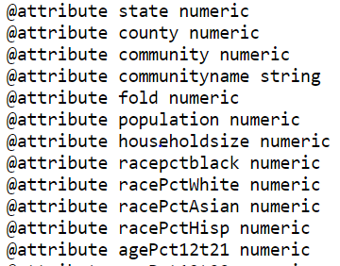
Data Set
Crime Rate in Communities within United States
and the data set is from UCI Repository.
Data set contains 128 attributes and 1994
instances.
After pre-processing the number of attributes
were reduced to 104.
Minor modification considered on the dataset is
numeric data is normalized to the range 0.00-1.00
Data set includes features like population of a community,income,education,illegal activities,
People living in city, police officers etc.

Slide 4
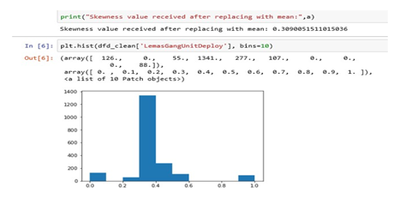
Data Cleaning and Preprocessing
Remove special character and punctuation, remove unwanted spaces.
Replacing null values with the mean as it maintained the distribution.
Also checked for the skewness by plotting the data by the histogram.

Slide 5
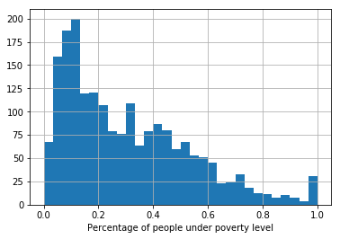
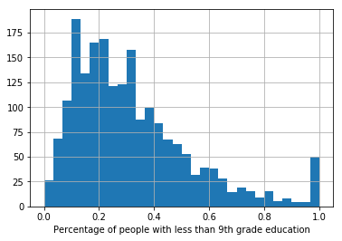
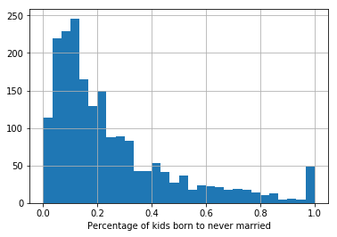
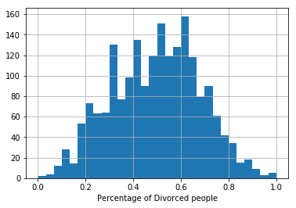
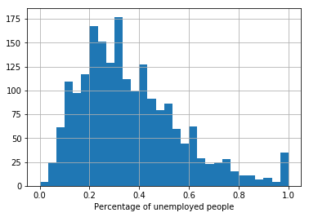
Data Preparation
We plotted histogram for top features which are highly correlated with ‘ViolentCrimesPerPop’.

Slide 6
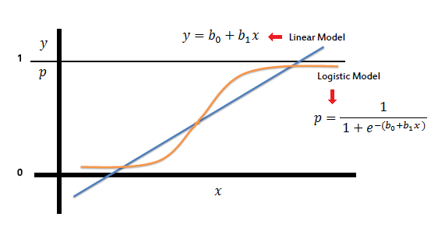
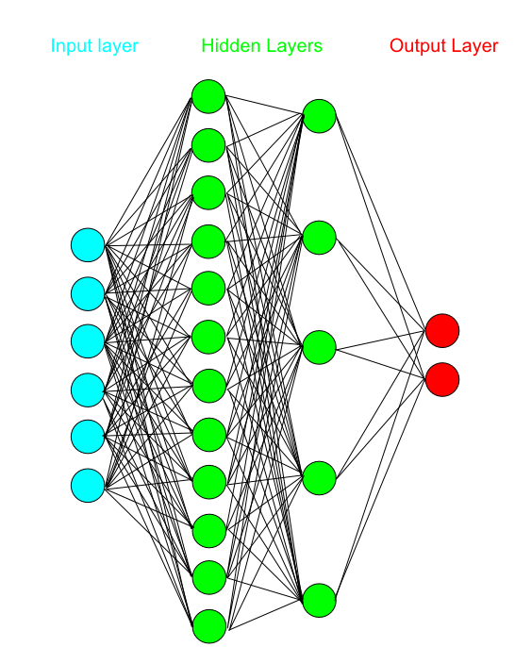
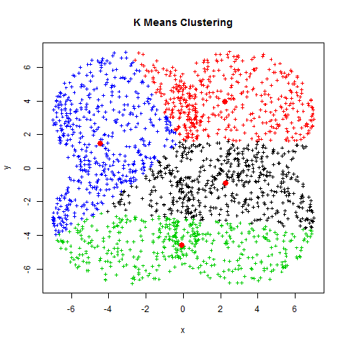
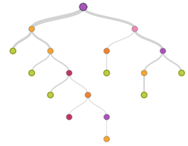
Approaches and Models Implemented
K-Means
Decision Trees
Linear Regression
Ridge Regression
Multi-Layer perceptron

Slide 7
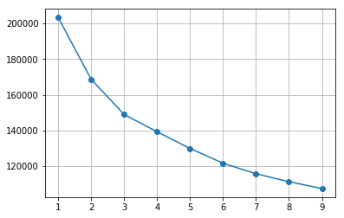
K-means
Using K-means all the states are grouped into two clusters based on crime rate.
Based on the results states with crime rate >0.4 are labeled as High Crime Area and states with crime rate<0.1 are labeled as Low Crime Area.
From the elbow method graph it is clear that number of clusters is 2.

Slide 8
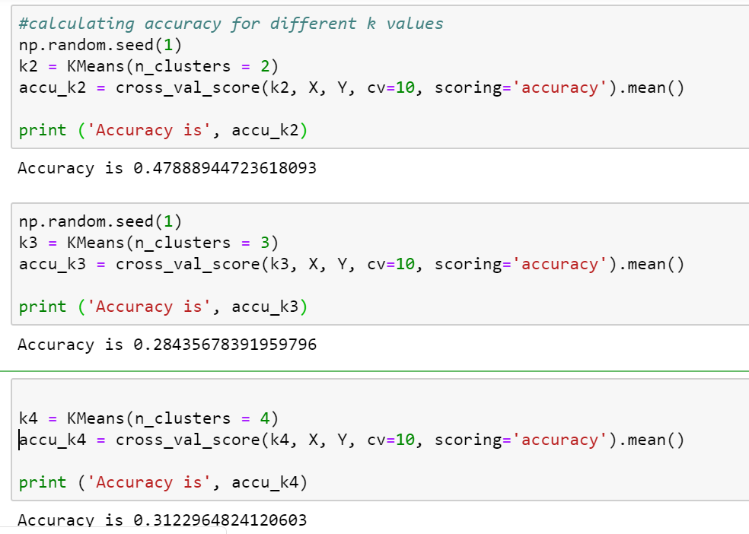

Slide 9
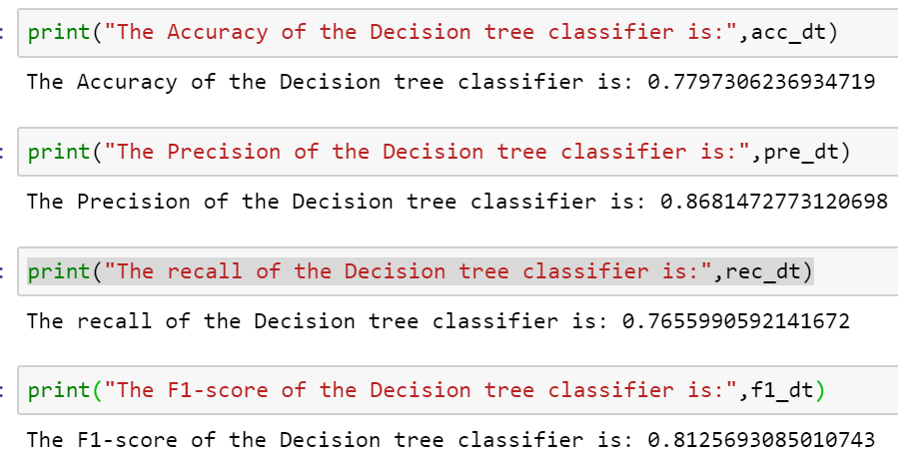
Decision Trees
Varied the training data from 70 to 90 % to see how the accuracy is affected and selected the best performing. The test train split taken is 0.15.
Used sklearn Metrics to compute Accuracy, Recall, precision and F1-Score.
The values of the accuracy, precision,recall and f1-score, obtained are:

Slide 10
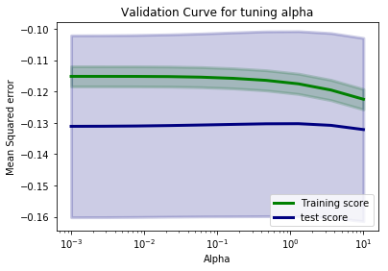
Ridge Regression
When we fit ridge regression for different value of alpha
For lower value of alpha overfitting is evident and higher value of alpha underfitting is evident.
In order to reduce underfitting and overfitting we fine tune alpha using cross validation
For 0.01 being the alpha value we found that the estimated function tracks the actual function.
alpha | MSE
0.001 | 0.13086
0.01 | 0.13076
1 | 0.13088
10 | 0.1321

Slide 11
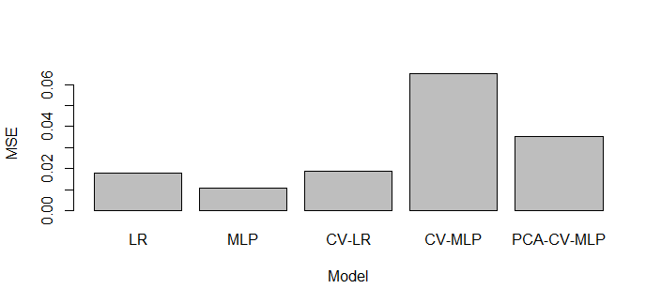
Multilayer Perceptron (MLP)
Multiple models were performed to test and compare the MLP.
1) Linear Regression CV Linear Regression
2) MLP CV MLP PCA CV MLP

Slide 12
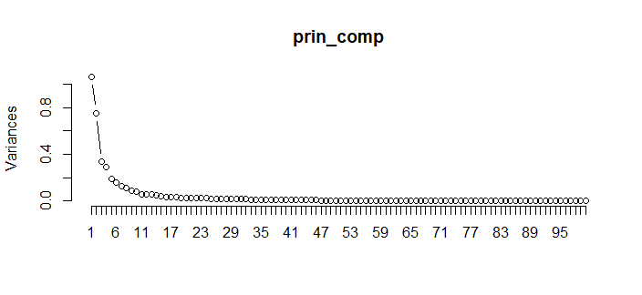
PCA Choice

Slide 13
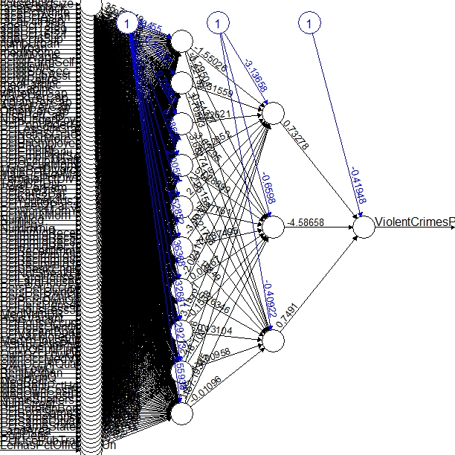
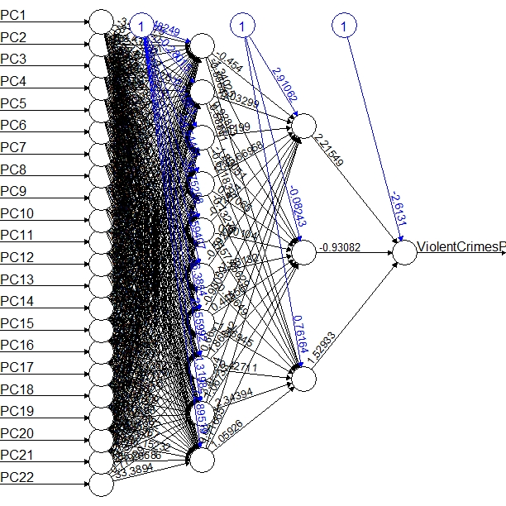
PCA Node Reduction

Slide 14
Conclusion
Comparative analysis of algorithms prove that not every model is a best fit to the data.
The best model found out to be Linear Regression which has the least MSE compared to other models.
We learnt about the features that can have an effect over prediction of Crime rate in USA.
Features affecting high crime are – under poverty, low high school graduates, divorced people.
Features for low crime are - Parents are with children and vice-versa (PCtFarm2Par, PctKids2Par), increase in women employment and high household income.

